Slide 1
Intro to RPi (Part 1)
By SUTD IEEE

Slide 2
Agenda
Setting up your RPi
Install Raspbian
Configure Wi-Fi
Set static IP
Setup SSH
Setup VNC
Using the RPi through the Terminal
Using the RPi like an Arduino
GP I/O Pins with Python

Slide 3
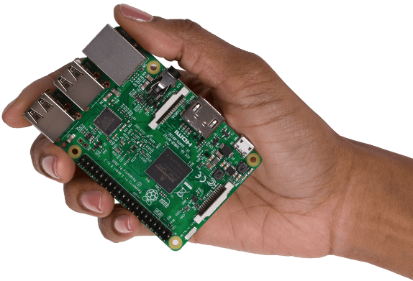
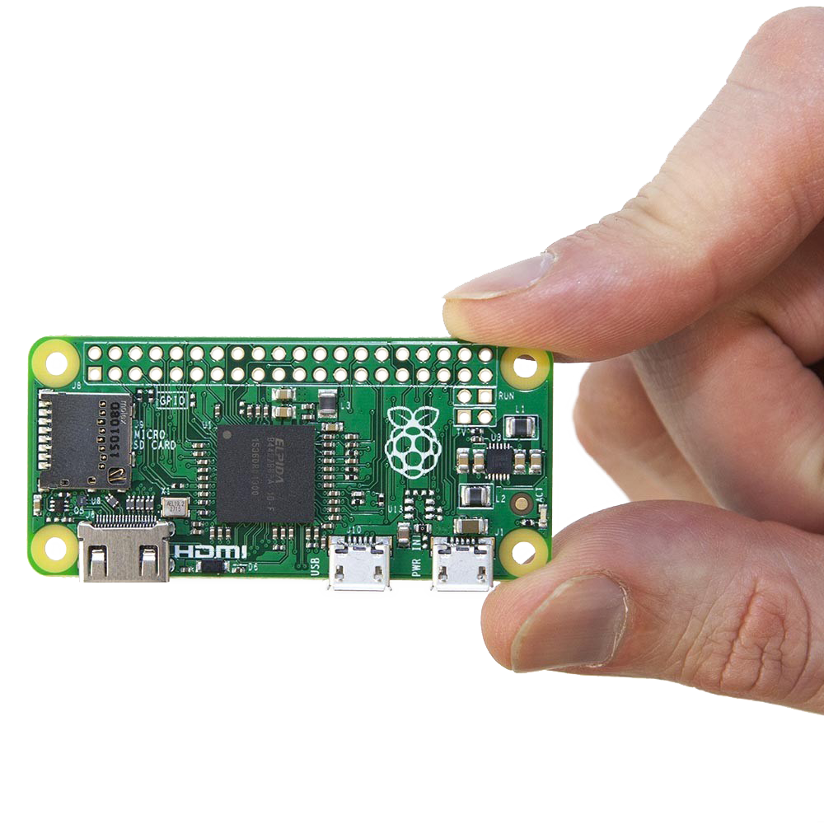
What’s an RPi?!
Single Board Computer
Runs Linux (Most of the time)
Small
System on a Chip (SOC)
All/ most important components are on a single chip (CPU, memory, storage, IO)
Access to GP I/O Pins (Input and Output)
Like an Arduino

Slide 4

Uses of RPi’s
Web Servers
Cloud Servers
Home Automation
Home Security
Arcade Games
Supercomputing (Clusters)
Cryptocurrency mining
Robotics
…

Slide 5
Installing Raspbian on the RPi’s SD Card
Copy Etcher and the Raspbian image to your computer
Connect the microSD Card
Open Etcher
Select the Raspbian image
Click ‘Flash!’

Slide 6
Setting Up Wi-Fi
Raspbian does not have a GUI that supports WPA2 Protocol
Cannot connect to SUTD_Student directly!
Need to configure it manually
Configure network in /etc/wpa_supplicant/wpa_supplicant.conf

Slide 7
Setting Up Wi-Fi
Open Terminal
sudo nano /etc/wpa_supplicant/wpa_supplicant.conf
Add this to the file: network={ ssid=“SUTD_Student” key_mgmt=WPA-EAP eap=PEAP identity=“100XXXX” password=“YOUR_PASSWORD” phase1=“peaplabel=0” phase2=“auth=MSCHAPV2” }
Reboot

Slide 8
Set Static IP Address
What’s an IP(v4) Address?
Why? So we can connect to the RPi at the same address every time.
Open Terminal: ip -4 addr show | grep global ip route | grep default | awk '{print $3}’ cat /etc/resolv.conf

Slide 9
Set Static IP Address
sudo nano /etc/dhcpcd.conf
Add this to the file: interface wlan0 static ip_address=10.1.1.31/24 static routers=10.1.1.1 static domain_name_servers=10.1.1.1
Reboot

Slide 10
What is SSH (Secure Shell)
It is a protocol that allows a computer to remotely log in to another through the Terminal, allowing you to use that computer.
In this case the RPi

Slide 11
Setting up SSH
GUI
Open ‘Applications Menu’ (Top Left) >> ‘Preferences’ >> ‘Raspberry Pi Configuration’
Select the ‘Interfaces’ tab; enable SSH
Command Line
Run: sudo raspi-config
Navigate to interfaces; enable SSH

Slide 12
Setting up VNC (Virtual Network Computing)
RealVNC – Free!
GUI
Open ‘Applications Menu’ (Top Left) >> ‘Preferences’ >> ‘Raspberry Pi Configuration’
Select the ‘Interfaces’ tab; enable VNC
Command Line
Run: sudo raspi-config
Navigate to interfaces; enable VNC

Slide 13
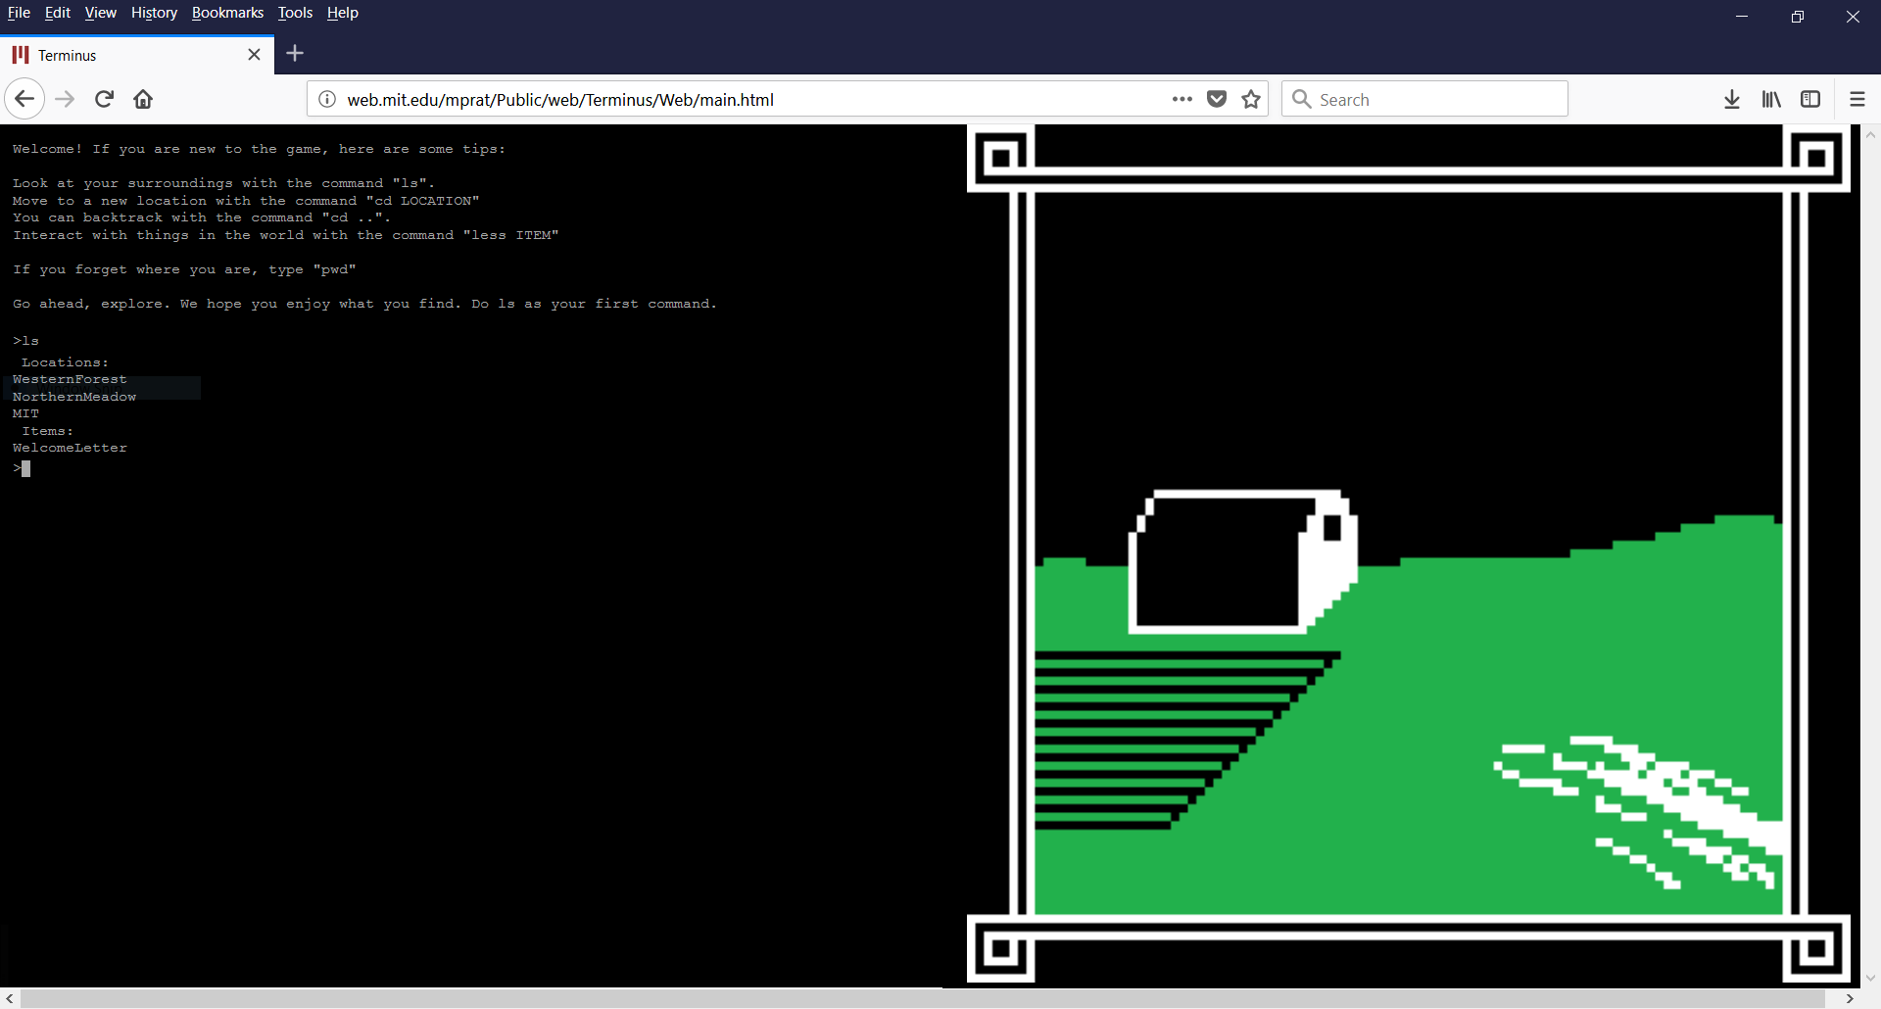
Using the RPi through the Terminal
www.mprat.org/Terminus/
Learn Linux commands to navigate and control the file system.

Slide 14
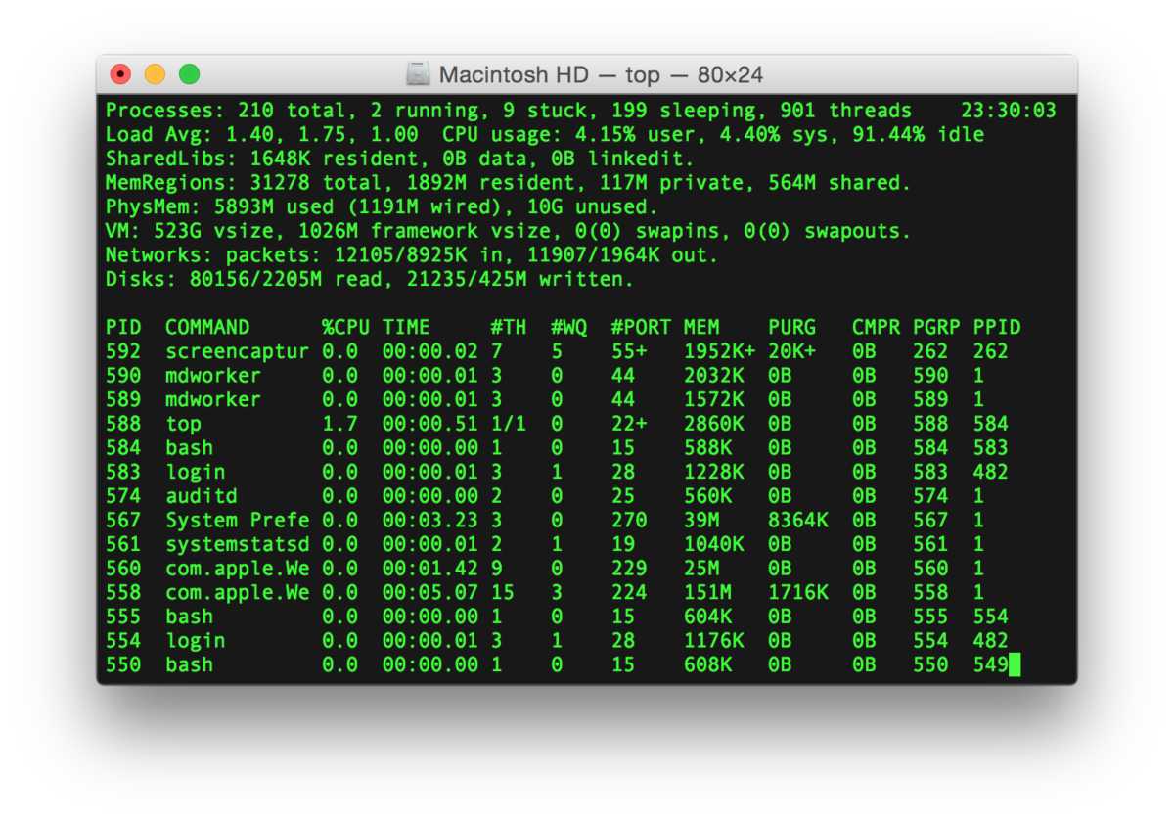
Linux Commands & Tools
cd
ls
touch
rm
mkdir
rmdir
nano/ vi
mv
cp
find
cat
ifconfig
http://www.informit.com/blogs/blog.aspx?uk=The-10-Most-Important-Linux-Commands

Slide 15
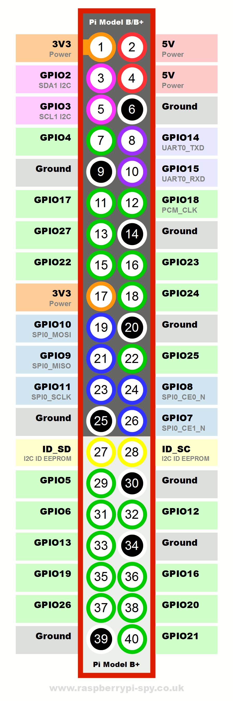
Now for the Electronics Stuff
Program the RPi’s GP I/O Pins
General Purpose Input/ Output
https://pinout.xyz/#
Use it like an Arduino
Can be done using Python, C, C++, NodeJS, Bash, etc.

Slide 16
GP I/O with Python
Install RPI.GPIO
sudo pip install rpi.gpio
In Python
import RPi.GPIO as GPIO

Slide 17
GP I/O with Python
GPIO.setmode(MODE) => MODE is GPIO.BOARD or GPIO.BCM
GPIO.setup(channel, GPIO.HIGH) => channel can be a list of channels
GPIO.setup(channel, GPIO.HIGH, initial=GPIO.HIGH)
GPIO.input(channel)
GPIO.output(channel) => channel can be a list of channels
GPIO.PWM(channel,frequency)
GPIO.cleanup()

Slide 18


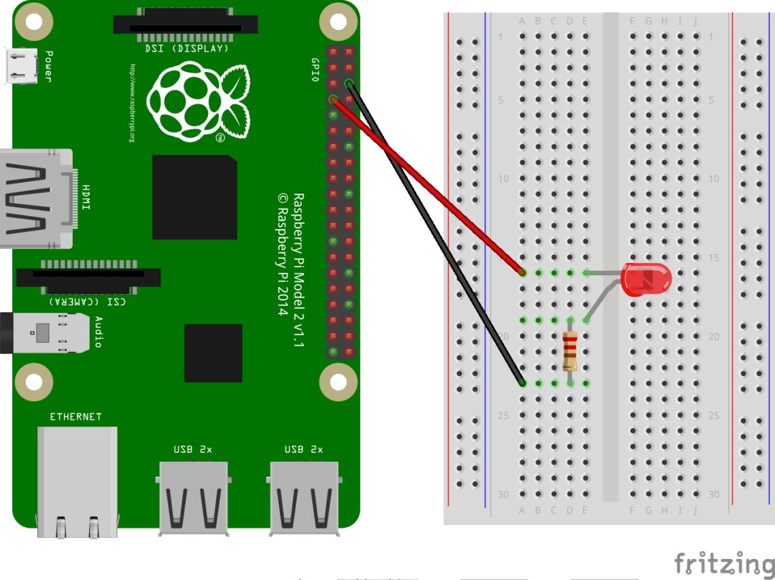
Activity #1: Blinking LED
Connect +ve lead of LED (Longer leg) to BCM26
Refer to https://pinout.xyz/# !
Connect a resistor from the –ve lead of the LED to an empty space
Connect the resistor to a GND pin
Refer to https://pinout.xyz/# !

Slide 19
Activity #1: Blinking LED
import RPi.GPIO as GPIO
from time import sleep
import sys
GPIO.setmode(GPIO.BCM)
GPIO.setup(26,GPIO.OUT)
GPIO.output(26,GPIO.HIGH)
sleep(1) // Sleep for 1s

Slide 20
Activity #1: Blinking LED
Try:
while True:
# Do Something
finally:
GPIO.cleanup()
sys.exit()

Slide 21
Activity #2: Fading LED
Connect +ve lead of LED (Longer leg) to BCM26
Refer to https://pinout.xyz/# !
Connect a resistor from the –ve lead of the LED to an empty space
Connect the resistor to a GND pin
Refer to https://pinout.xyz/# !

Slide 22
Activity #2: Fading LED
pwm = GPIO.PWM(26,1000)
pwm.start(0)
pwm.ChangeDutyCycle(x)
for i in range(100):

Slide 23
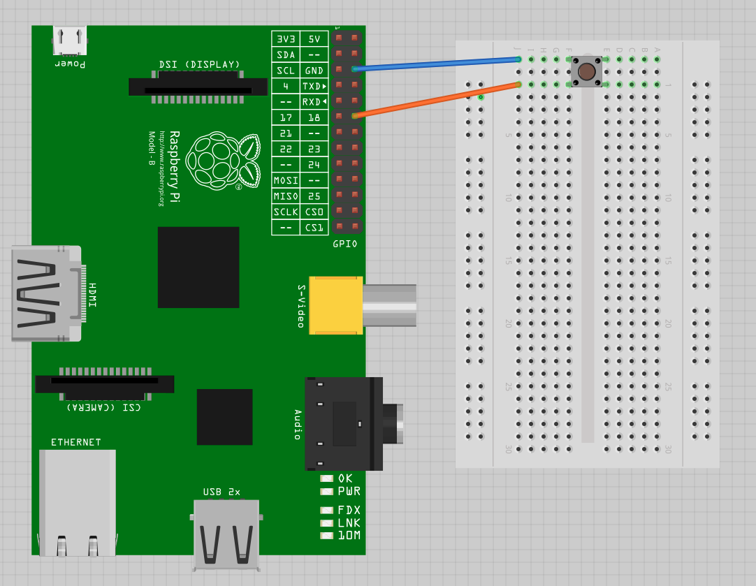
Activity #3: Push Button
Connect one end of the button to BCM26
Connect the other end on the same side to GND

Slide 24
Activity #3: Push Button
GPIO.input(26)

Slide 25
Activity #4
Use a push button to toggle an LED on and off!
TRY!

Slide 26
The ENd

